Slide 1
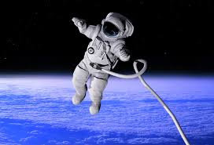
Gravity

Slide 2
Objects fall because a force pulls them to the ground. A force is a push or pull.
The force that causes objects to fall is called gravity.
Gravity is a force that pulls objects toward one another. It pulls objects toward Earth. If you jump into the air, gravity will pull you back to Earth. Because of gravity’s pull, the planets travel in paths around the sun.

Slide 3
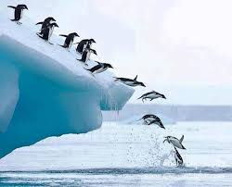
Kids are going down the slide because gravity pulls them towards the Earth.
The penguins are diving off a cliff. They don’t hang in the air, they don’t float up. Gravity pulls the penguins down toward Earth and into the water.

Slide 4
Because of gravity’s pull, the planets travel in a path around the sun. What is gravity?

Slide 5
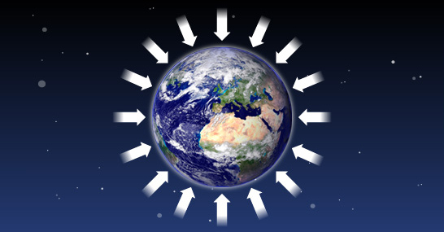
Gravity is the force of attraction (pulling force) between objects that have mass. The strength of gravity between objects depends on two things: 1. the mass of objects 2. the distance between them.

Slide 6
Weight is the measure of the pulling force of gravity on an object.
Weight can vary depending on mass (more massive objects have more pulling force) or distance (the farther an object is from the center of gravity the less pulling force).

Slide 10
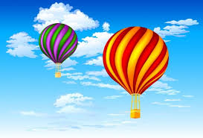
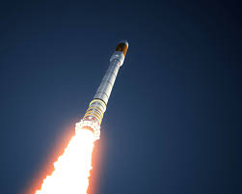
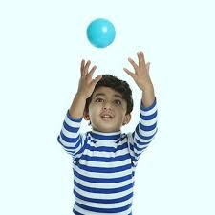
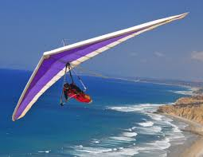
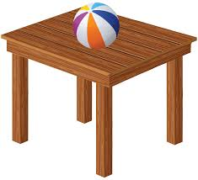
Defying Gravity

