Slide 1
Experimenting With Forces
Picture Vocabulary
4.P 12.1 and 12.2 Experimenting with Forces

Slide 2
Force
A push or pull that causes an object to move, stop, or change direction

Slide 3
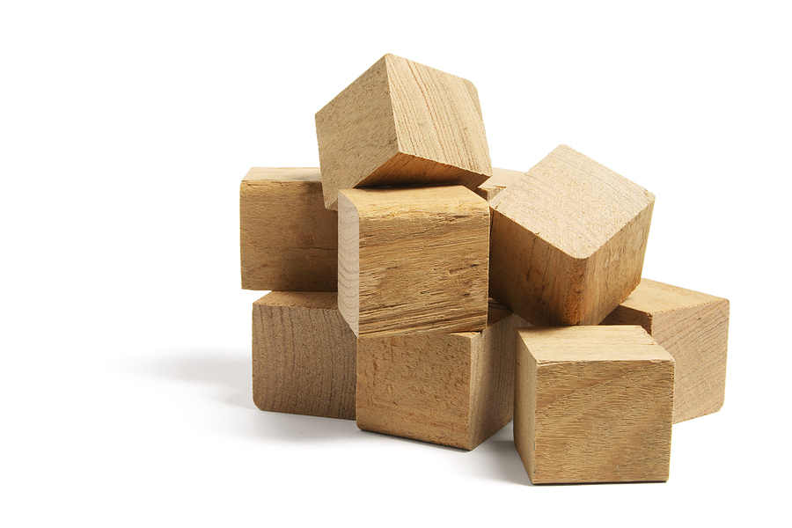
Object
Anything that is visible or able to be touched

Slide 4
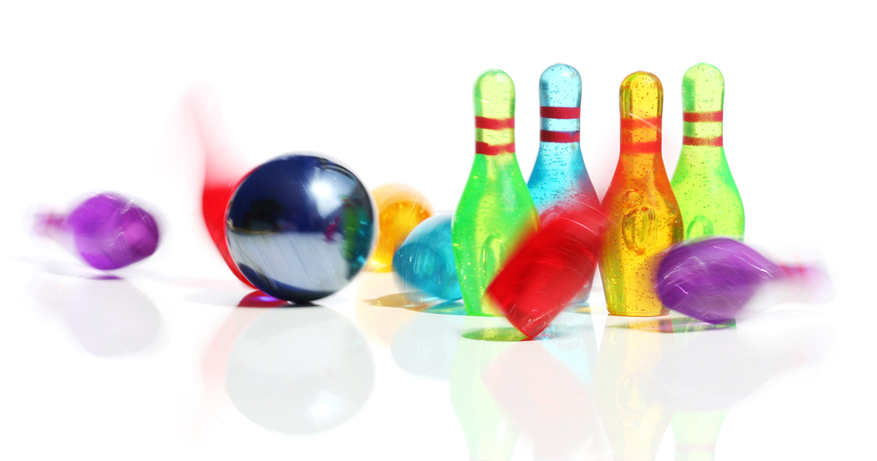
Motion
Describes change in an object’s position with respect to time and in comparison to other objects

Slide 5
Direction
A straight path that something could move along

Slide 6
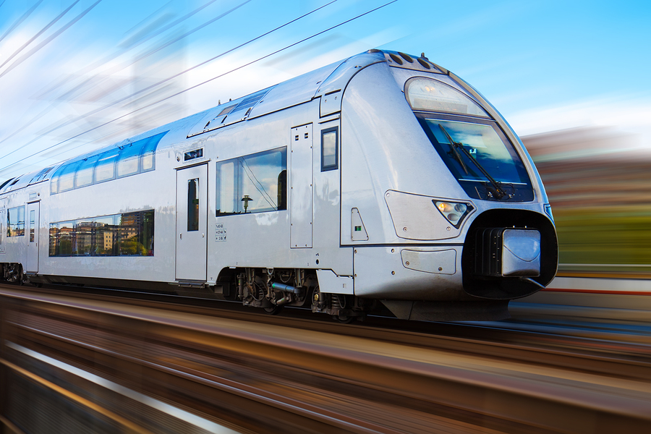
Speed
Rate of motion

Slide 7
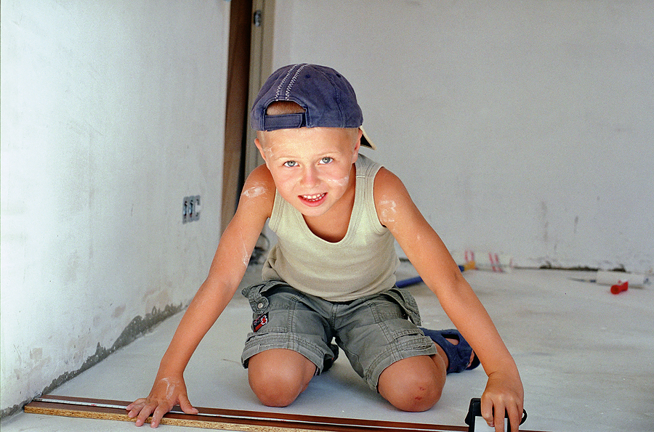
Distance
How far from one point to another point

Slide 8
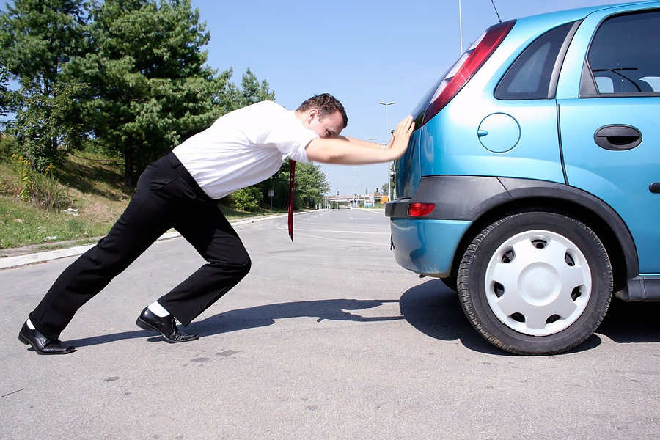
Push
To use force to cause something to move away

Slide 9
Pull
A force that brings something closer

Slide 10
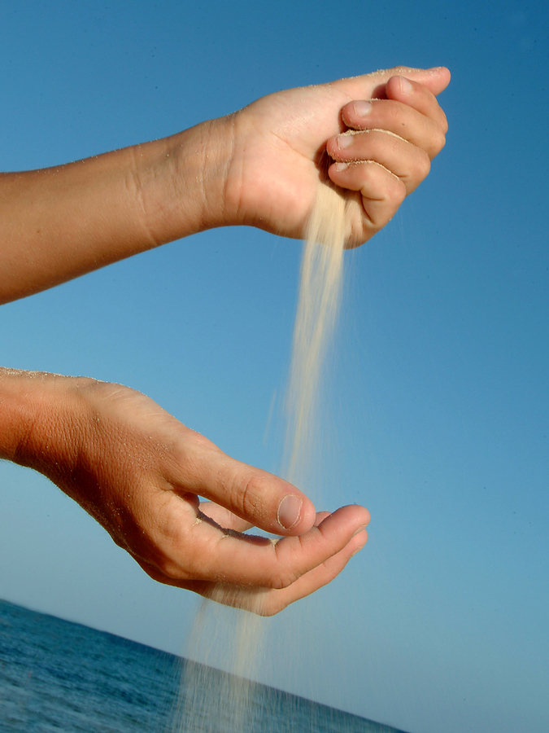
Gravity
A force that causes objects with mass to attract each other

Slide 11
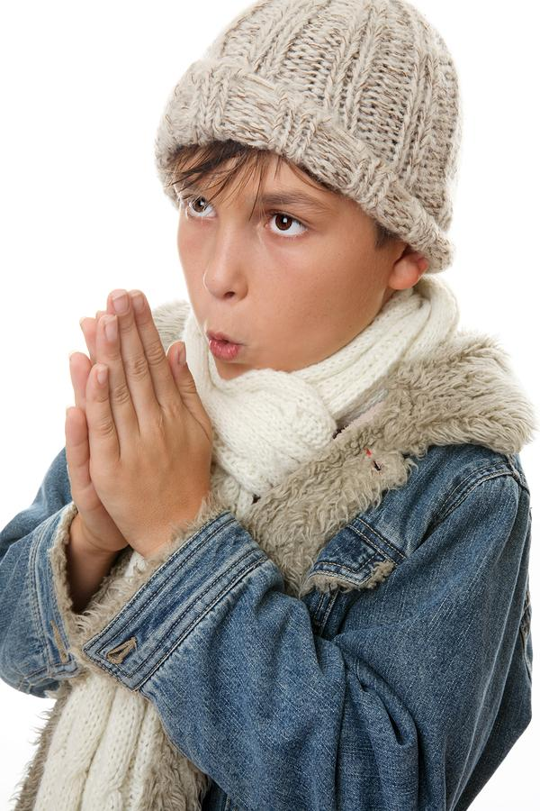
Friction
A force that resists the motion of two surfaces sliding across one another

Slide 12
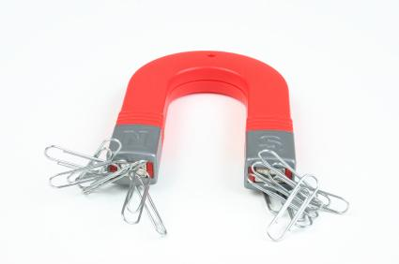
Magnetism
Force produced by a magnet

